Slide 1
Software

Slide 2
Software
Dan Bricklen made the first software program for spread sheet called VisiCalc. It helped banks and accountants to add and subtract, multiply, and divide numbers faster.
1982 Lotus 123 came to the market
Andrew Flegleman created PC-Talk. A program that could communicate through the phone line. It was free software (freeware or shareware software)

Slide 3
Programming language
“A programming language is an artificial language designed to express computations that can be performed by a machine, particularly a computer. Programming languages can be used to create program that control the behaviour of a machine and/or to express algorithms precisely.”
(http://en.wikipedia.org/wiki/Programming_language)
Monday

Slide 4
Continued: http://en.wikipedia.org/wiki/Programming_language
“A programming language is usually split into the two components of syntax (form) and Semantics (meaning). ”
What is a syntax?
It specifies the spelling and grammar of a programming language. It is structure.
Example: numberOfChildren = width
Monday

Slide 5
Overview of Program Execution
1- Program is loaded from some external device (hard drive, floppy, etc)
2- Program is stored in memory (RAM)
3- In the processor is the Program Counter – starting address of program
4-Program will manipulate RAM according to its interpretation each instruction
5- Executes one instruction at a time
Monday

Slide 6
Major Computer Languages
Cobol
Fortran
PL/1
C
C++
Perl
Java
PHP
Monday

Slide 7
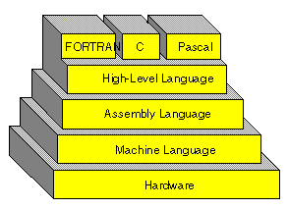
Programming language?
Set of rules and instructions that tell computers what to do for a specific task.
Type of language:
1- Machine Language
2- Low Level or Assembly Level
3- High Level

Slide 8
1-Machine Language
It is a language that works only with binary and Hexadecimal numbers, which means 0 or 1 or DF4C2.
Computer (hardware) follows these bits as an instruction to do a task.
It is written for each individual chip. It is a complicated language, due to the numbers, which humans don’t easily understand.
It communicates with hardware .

Slide 9
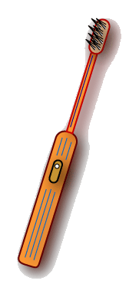
Machine language instructions
Machine Instruction | Machine Instructions
0000 0000 | Stop
0000 0001 | Rotate bristles left
0000 0010 | Rotate bristles right
0000 0100 | Go back to beginning of program
0000 1000 | Skip next instruction if switch is off
Memory address | Machine Instructions
0 | 0000 0000
1
2
3
4
Memory

Slide 10
2- Low Level (Assembly language)
Assembly language is a simple language written in Words but in abbreviation terms. Then converted to Machine code by the Assembler
Example:
MOV EAX,1
SHL EAX, 5
MOV ECX, 8
SUB EAX, EAX

Slide 11
3- High Level Language
Such languages are considered high-level because they are closer to human languages and further from machine language,
Example:
C, C++, Cobol, Fortran, Pascal,

Slide 12
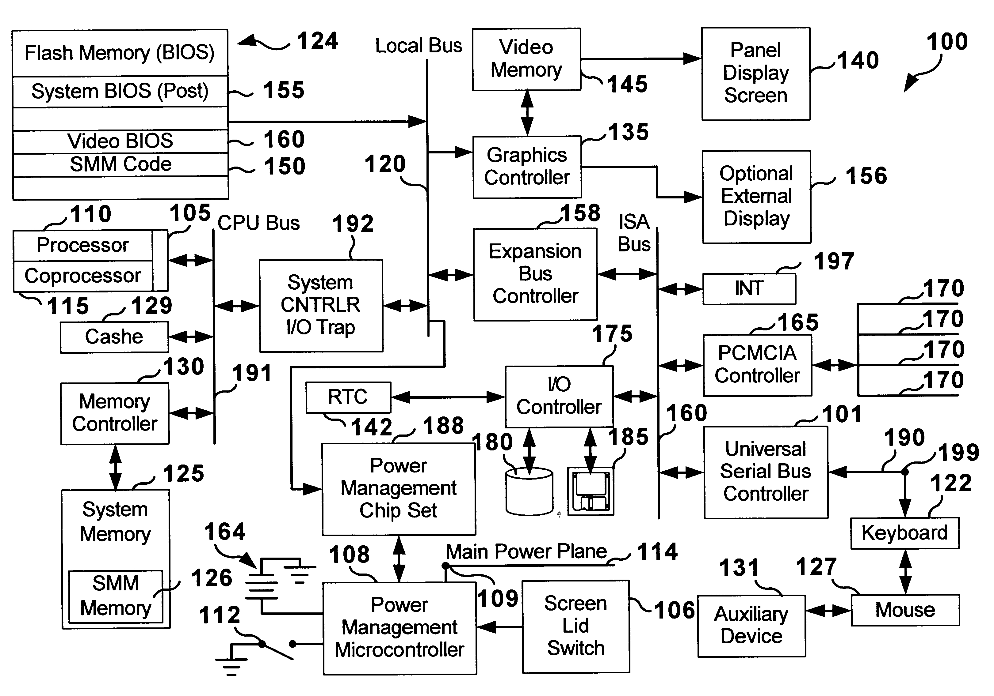
Operating System
It is a program that allows devices like video, sound, modem and NIC cards, mouse, keyboards,
monitors and so on to communicate with each other.

Slide 13
Windows OS type
DOS (command line) Disk Operating System: a 16 bit, single task
Windows 3.0, 3.1, 3.5: a 16 bit, GUI (Graphic User Interface) interface
Windows 95, 98, ME, NT 4.0, 2000, XP, Vista, & 7:
32 bit, multi taking, GUI interface

Slide 14
Windows and DOS Operating system
DOS
Windows
Command line
16 bit
Single task
GUI( Graphical User Interface)
32 bit
Multitasking

Slide 15
Windows 7
It is an OS which released in 2009 by Microsoft. It was a follow up to Window Vista.
It is a GUI (Graphical User Interface).
It is a 32 and 64 bit OS

Slide 16
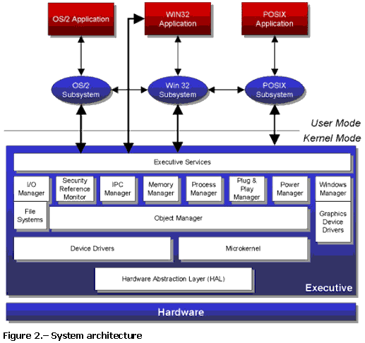
Windows Kernel and user mode
Ring 1
Ring 0

Slide 17
Windows Kernel
The Windows 9x kernel is a MS-DOS kernel with additional support for security in memory and virtual memory. The kernel has very basic support for device interfacing. Everything that is not under the DOS 16-bit kernel is run in User space.
What Kernel do?
  Memory management
  Process management
  File Management
  I/O (input/ output) management

Slide 18
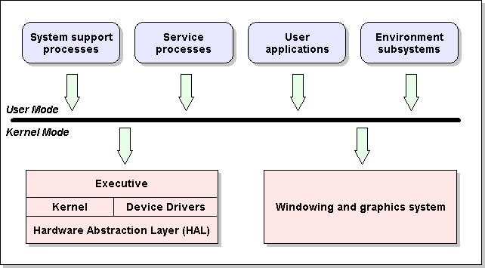
Windows system files
Dll (Dynamic link Libraries). These are the system files. Usually used for command like Open file, File Save, Search print and more.
API (Application Programming Interface)

Slide 19

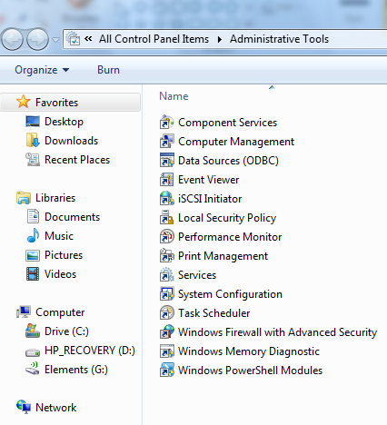
Administrative tool

Slide 20
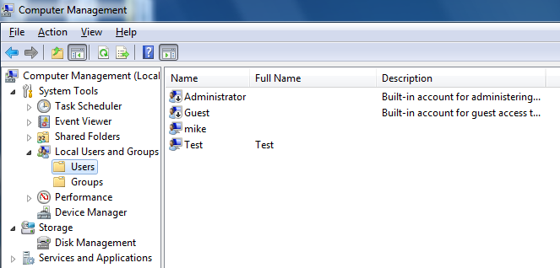
Computer Management

Slide 21
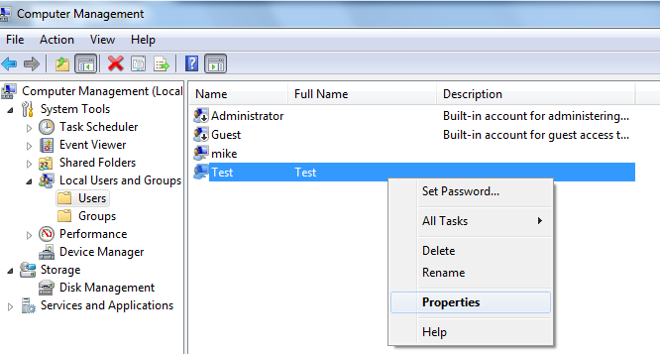
User properties

Slide 22
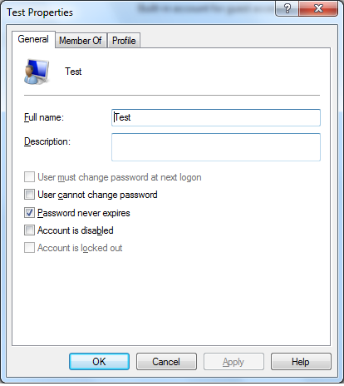
User Properties and password

Slide 23
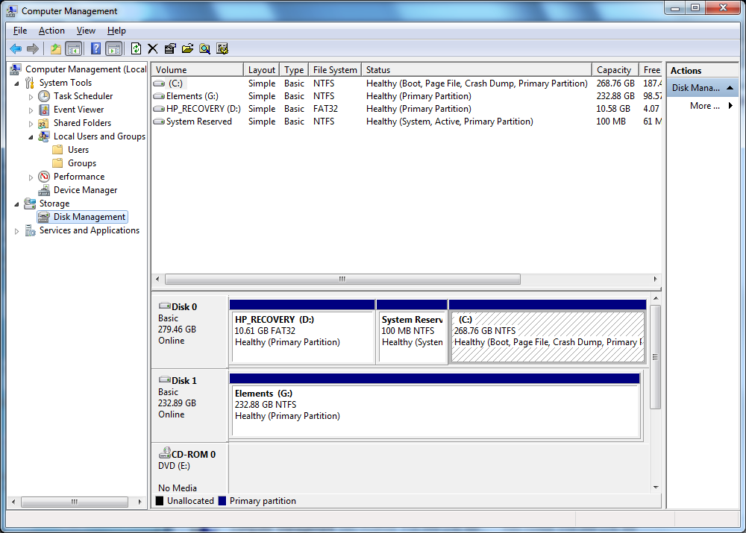
Disk Management
Default

Slide 24
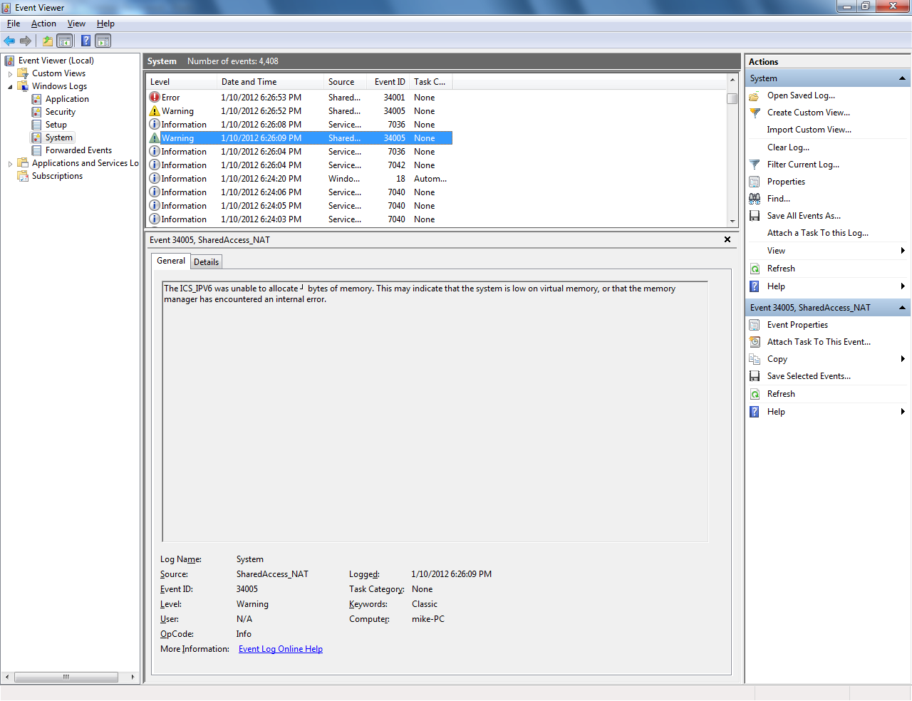
Event Viewer

Slide 25
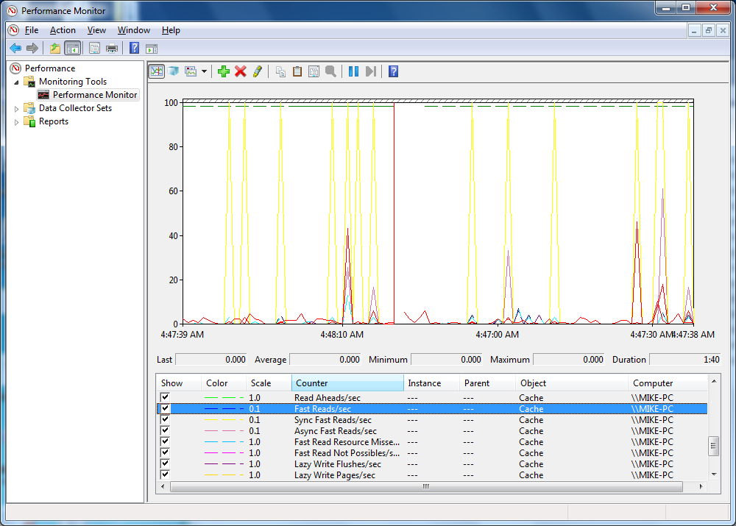
Performance Monitor

Slide 26
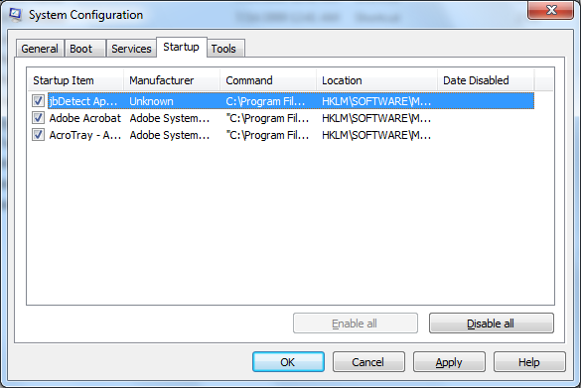
System tool (Msconfig) startup tab
TSR

Slide 27
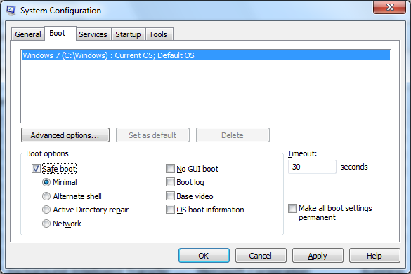
Msconfig
Boot tab

Slide 28
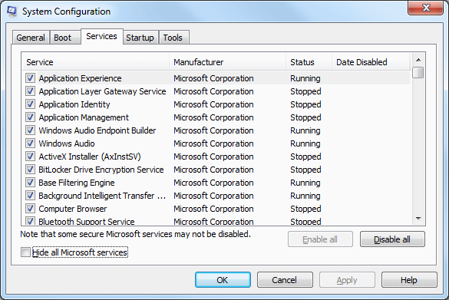
Service tab

